Slide 1
IWPA 2016-2017 Championships

Slide 2
IWPA Regional Hall of Fame
2016-2017 Season

Slide 3
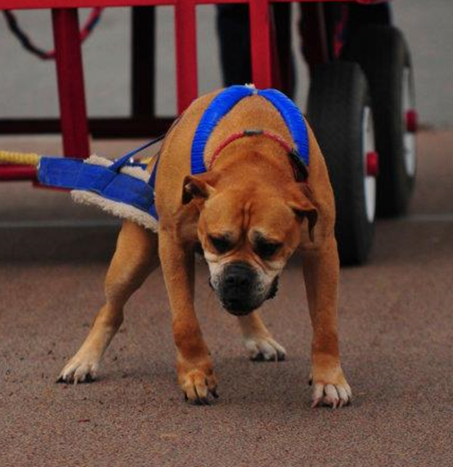
REGION 3 Willow’s Haven Brutus of Red Branch
Owner/Handler
Sean Hammell

Slide 4
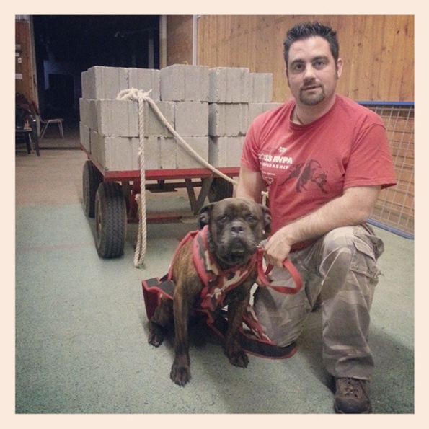
REGION 3 LGK’S Conan of Red Branch
Owner/Handler
Sean Hammell

Slide 5
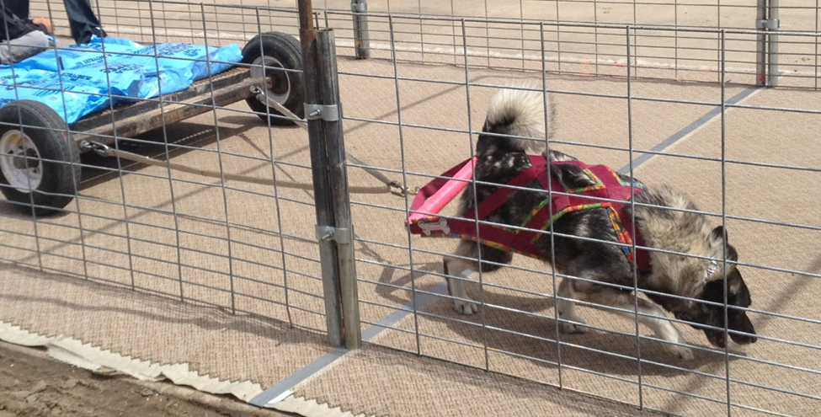
REGION 9 Demond
Owner/Handler
Cheryl Martin

Slide 6
IWPA National Hall of Fame Inductee applicants
2016-2017 Season

Slide 7
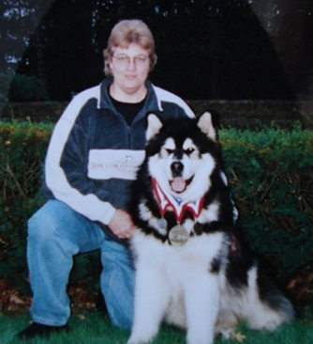
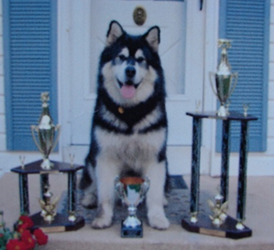
REGION 7 Bogie
Owner/Handler
Brenda Lemon and Valarie Thawley

Slide 8
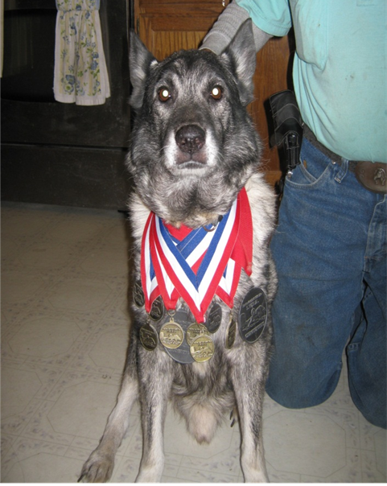
REGION 9 Silver
Owner/Handler
Rodney Martin

Slide 9
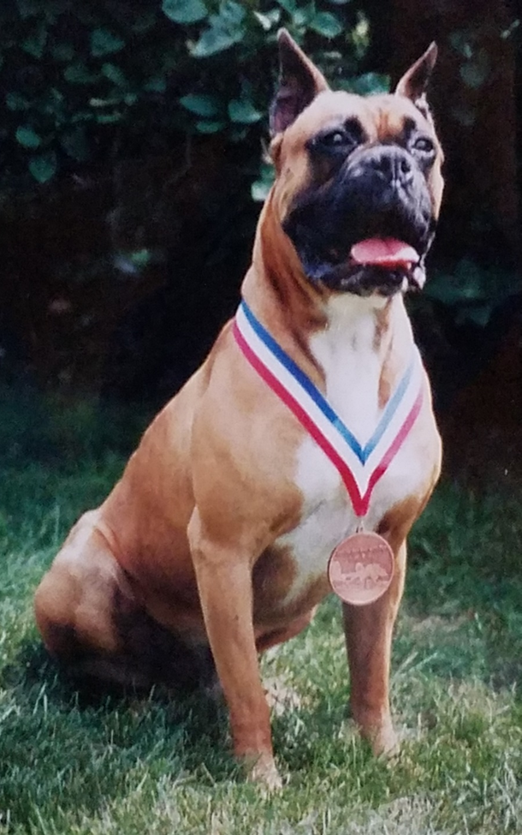
REGION 9 Samson’s Pride Prince Apollo
Owner/Handler
Terry Reed

Slide 10
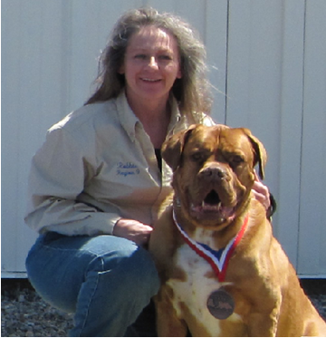
REGION 9 Baron Baxter
Owner/Handler
Robbie Reed

Slide 11
IWPA International Hall of Fame Inductee applicants
2016-2017 Season

Slide 12
REGION 2 Cascades Tropical Storm – aka “Stormie”
Owner/Handler:
Sue Ferrari

Slide 13
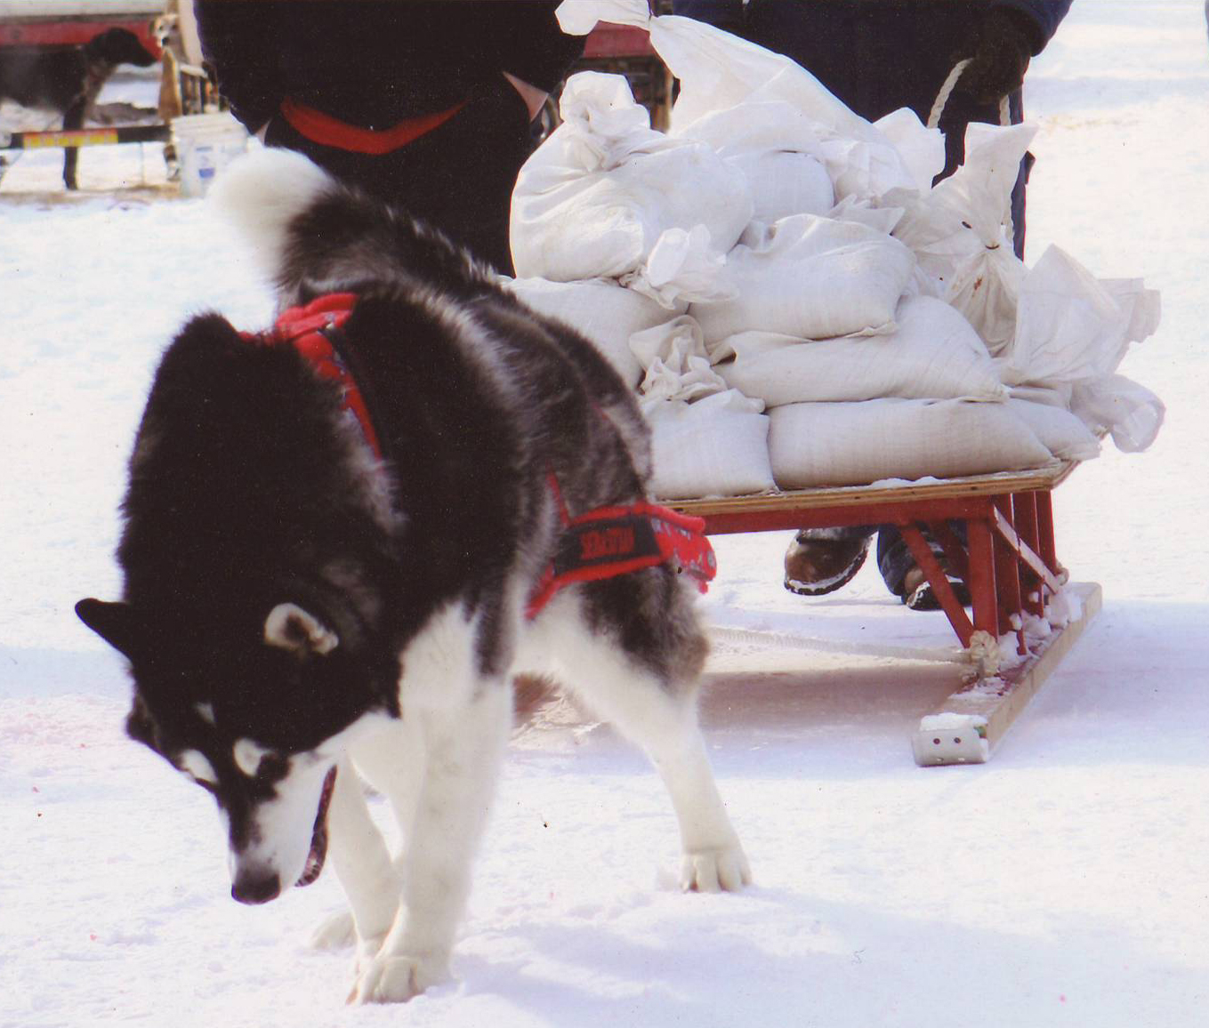
REGION 7 Sebastian
Owner/Handler
Sheryl Franklin

Slide 14
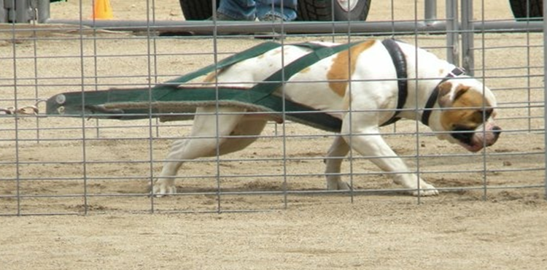
REGION 9 Woody
Owner/Handler
Chris Stock

Slide 15
IWPA International Hall of Fame Inductee’s
Inducted June 4, 2016

Slide 16
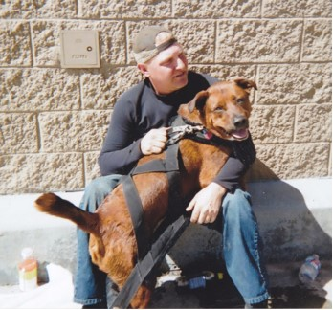
REGION 9 Galyith
Owner/Handler:
Richard Felice Sr.

Slide 17
Congratulations to all International and Regional Hall of Fame recipients!!!

